Slide 1

Brian Harfe, Ph.D
Associate Dean (Research, Online Education, Science/Math Depts., Special Programs, Exchanges)
Beth Eslick
Director, CLAS Research Office

Slide 2
CLAS RO
History
  Two years-old
  Beth Eslick, Founding Director
  Currently, eight people in the office (currently expanding)
  Web site is under construction
“Partner” and “Non-Partner” Units
Math is a new “Partner"Unit (Proposal(s) due to sponsor February 14th and after, then award action(s) starting April 1st.)

Slide 3
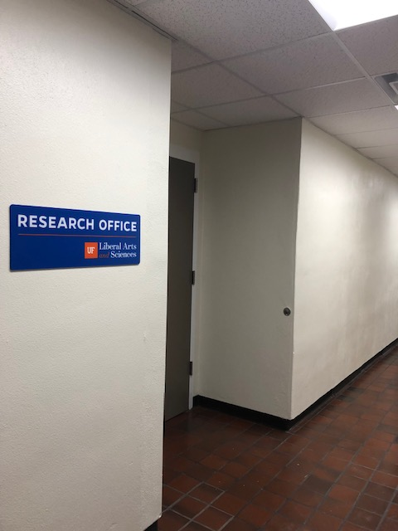

Slide 4
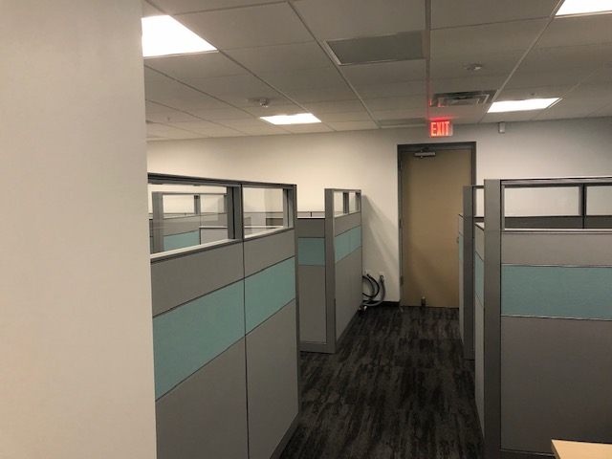

Slide 5
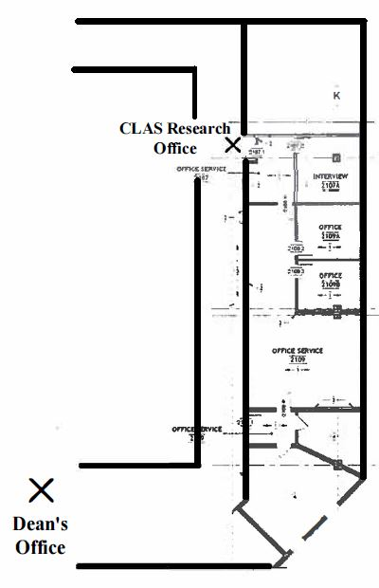
Turlington Hall
Room 2107

Slide 6

Staff
Research Administrators: Marah Berry,
Angela Cocchiarella, Marisa Gates, Tammy Lazarevic, Erika Railey.
Fiscal Assistant: Natalie Torres.
Collectively, the office has 36.5 years of experience in research administration and fiscal (research related).

Slide 7
Proposal
External/internal request for funds:
Solicitation: review which includes interfacing with core offices (Division of Sponsored Programs/DSP, Contracts & Grants/C & G and other compliance offices),
Budget: Development including incorporation of federal, state and local guidelines,
UFIRST entry(all),
Post submission updates: budget revisions, Just In Time/JIT,
Submission Portals/ Packages: FastLane, SF424 and other misc. sites,
Interface with DSP, as well as external partner and/or sponsor administrators.

Slide 8

Awards
Acceptance of external/internal funds:
UFIRST entry: initial and all modifications,
  No Cost Extension/NCE,
  Budget revision,
  Key personnel changes,
  Extensions with additional funding.
Cost Account Standards/CAS exemption entry,
Subaward entry,
Report management: example: RPPR(NIH).
Interface with C & G as needed.

Slide 9
CLAS Grant Submission Policy - deadlines
Must contact the CLAS Research Office no later than 10 business days from the sponsor’s or subcontracting partner’s deadline (as entered in UFIRST).
All final documents must be submitted to the CLAS Research Office 4 business days prior to the sponsor’s or subcontracting partner’s deadline.
The ten/four business day deadlines are inclusive of the 48hr UF Office of Research deadline.
If a proposal fails to meet either of these deadlines, the CLAS Research Office will not guarantee that the proposal will be submitted to the sponsor.
Any proposal containing cost share must be approved by Dr. Brian Harfe.

Slide 10
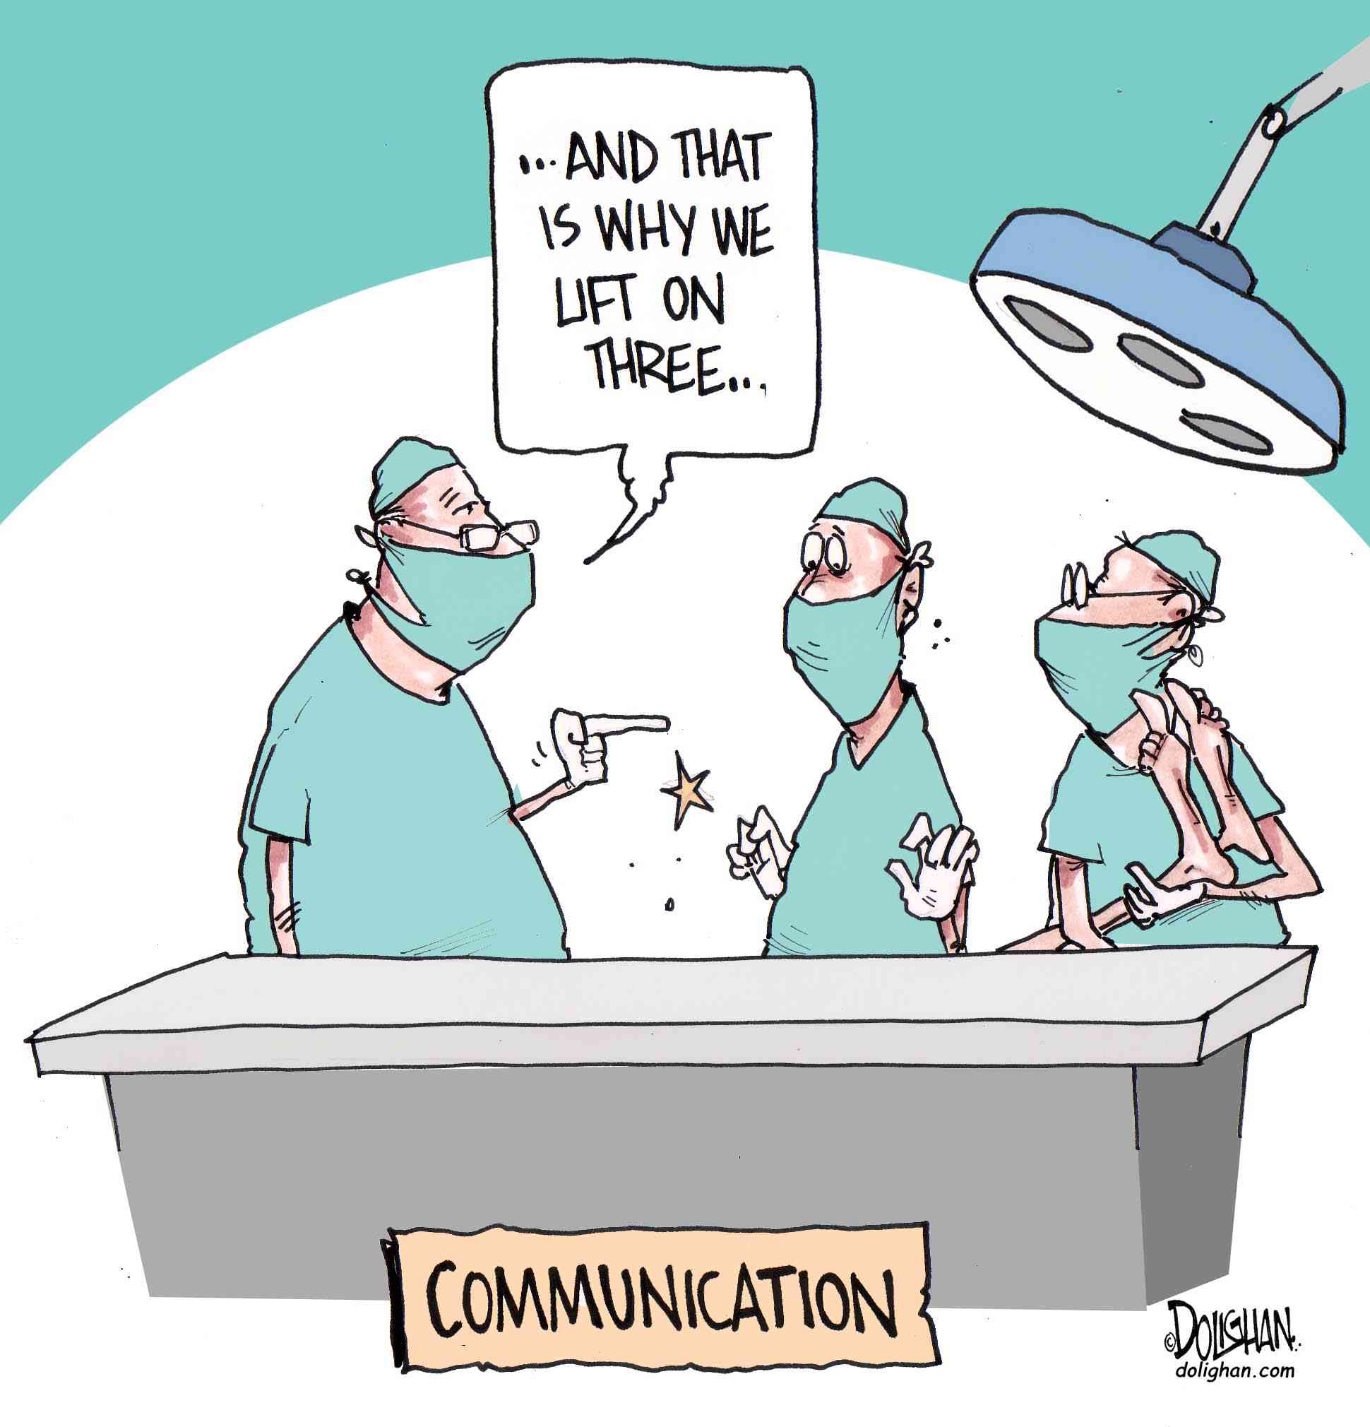
Communication
Early and often,
Think you might submit a proposal, then contact our office,
Question whether a submission should go through UF or not, contact our office,
Email: CLAS Research Office at: resoffice@clas.ufl.edu ,
Phone: 352.294.1388.

Slide 11
Brian Harfe, Ph.D
bharfe@ufl.edu
Beth Eslick
eeslick@ufl.edu

